Slide 1
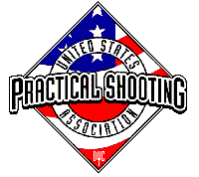
Stage 6 Circular Reference Course Designer: Rick L
Welcome to Stage 6, Circular Reference. I am Eric Beerbaum, your CRO and assisting me is Scott LeRoux. Circular Reference is a 30 round, 150 point Comstock Long course. There are 15 USPSA targets. The best two hits per target will score. The start signal is audible.
The start position is standing in the start box. Firearm is loaded and placed in box with lid closed on top IF the firearm fits inside the box. If not, firearm is placed in such a manner that the box lid is resting on top of it and no part of the firearm is touching anything but the lower part of the box.
On the audible start signal, engage all targets from within the shooting area.

